Slide 1
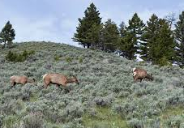
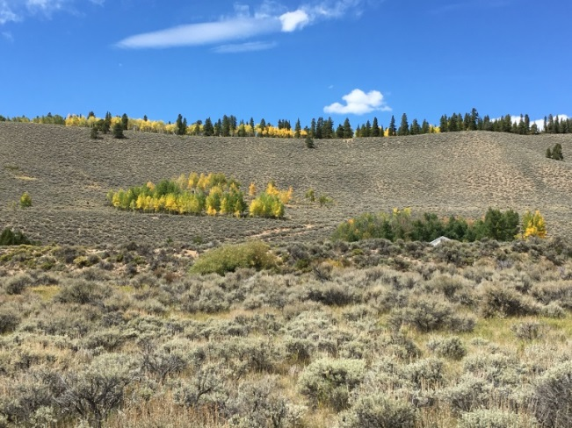
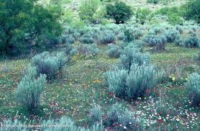
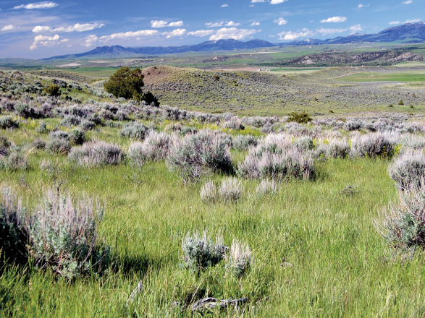
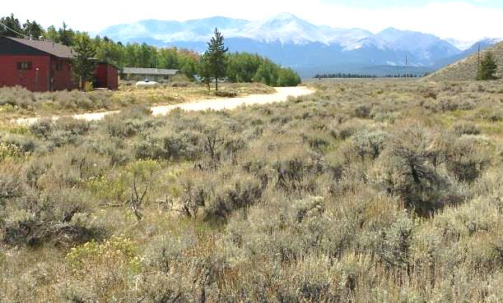
Sage Brush
Wildlife
Sage provides protection and cover for animals.
Thick sage brush reduces grasses that animals eat.
Fire
Sage Brush burns hot and fast.
It doesn’t re-sprout but relies on a seed source. Often times it is outcompeted by weeds after a fire.
How to Balance Fire Mitigation with Wildlife Habitat
Clear sage brush 15 feet from house.
Clear sage brush 5 feet on both side of roads.
Patch cut sage to have clumps of sage and clumps of meadows (2.5 times height of sage between clumps).
Thinned
Thick, limited grasses
Carrie Howard
ARWC Forester
Carrie@arkcollaborative.org

